Slide 1
RATING PREDICTION

Slide 2
ACKNOWLEDGMENT
I take great pleasure to thank and acknowledgement the allowance by Data Trained Education and permission by Flip Robo. I extend whole hearted thanks to them I worked and learned a lot and sharing me the knowledge and experience.
Data Trained Education and Flip Robo provided training is the very important to completion of project.

Slide 3
INTRODUCTION
Business Problem Framing
It describes the application of a range of supervised and unsupervised machine learning models to a dataset of Amazon product reviews in an effort to predict rating value. The desired output to an input of a text review is a “star” rating on a continuum from 1 to 5. Because we wish to produce a continuum of sentiment rather than just polarity, this project could be categorized as a regression variation of sentiment analysis.
Conceptual Background of the Domain Problem
Our goal is to produce the most versatile and accurate model that handles the widest range of mixed and polarized sentiments expressed in reviews.
Review of Literature
The article will first describe the curation of the dataset utilized to train and test the models, describing all review selection methodologies, pre-processing steps, and feature engineering.
Motivation for the Problem Undertaken
It concludes with overall results, major findings, and recommendations for improvement and future work.

Slide 4
Analytical Problem Framing
Mathematical/ Analytical Modeling of the Problem
This dataset contains information about Rating Prediction listed on train dataset. This data can be used for a lot of purposes such as Rating prediction to exemplify the simpler encoding options like Bag of Words and TF-IDF in Machine Learning.
Data Sources and their formats
The columns in the given dataset is as follows:..
The data set contains the training set, which has approximately 32,352 samples.

Slide 5
Analytical Problem Framing
The data set includes:
Ratings: It contains the rating of amazon data.
Review: It contains the review of amazon data.

Slide 6
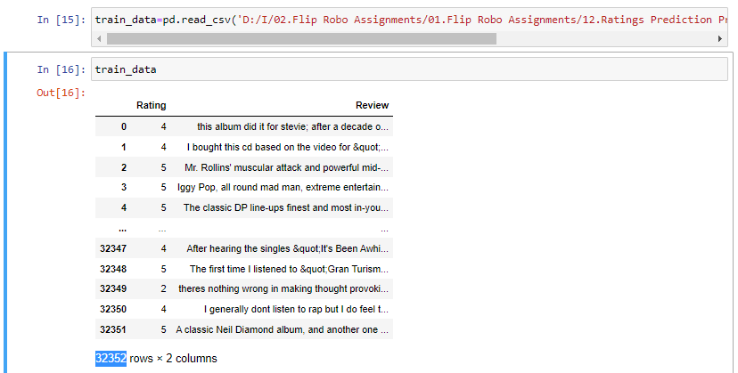
Data Sources & Formats
Collected dataset using scrapping the data as below:

Slide 7
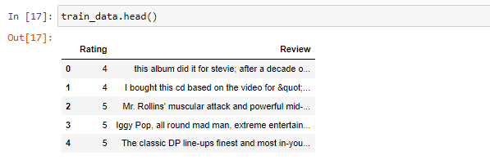
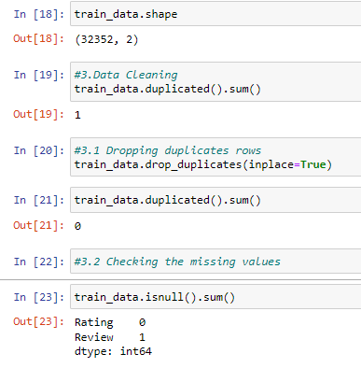
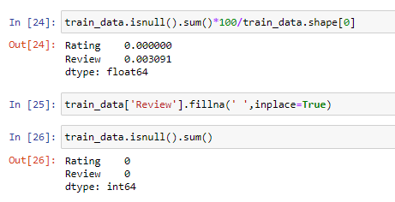
Checking Null Values
After that we are checking if Null values are present in datasets & removing null values from dataset.

Slide 8
Hardware and Software Requirements and Tools Used
The needed time to train the model depends on the capability of the used system during the experiment. Some libraries use GPU resources over the CPU to take a shorter time to train a model.
Also we are using Jupiter notebook for running the code
Operating System | Windows 10
Processor | Core i7
RAM | 16GB
Graphics card | 1080 TI OC

Slide 9
Model/s Development and Evaluation
Identification of possible problem-solving approaches (methods)
consider reviews written by verified purchasers to decrease the risk of fraudulent reviews with dubious ratings. Only star_rating, review_headline, and review_body columns were considered to reduce feature complexity.

Slide 10
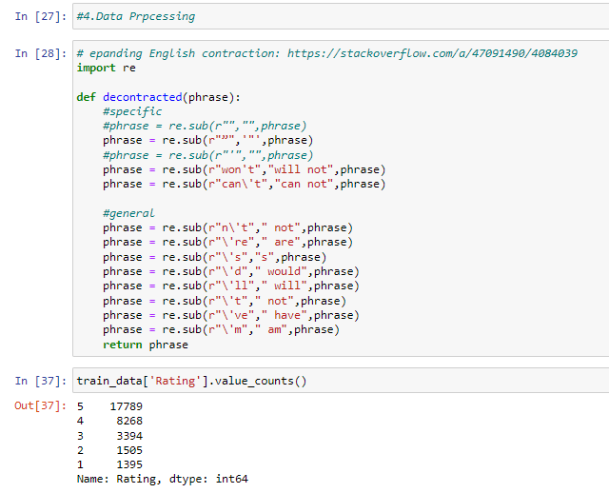
Data Preprocessing
Text preprocessing is an important step for any natural language processing task. It transforms text from its raw format into something that is more processable for computer algorithms.

Slide 11
Removing Stopwords
Stop words are common words that structure a sentence. Words such as “I”, “are”, and “here” do not contribute to the sentiment — the rating in our case — of reviews. Hence, we decided to remove stopwords to further denoise the input. We used NLTK’s stopwords package to provide us with the list of stopwords. Here, we made an adjustment to avoid the removal of certain negation stop words, namely“not” and “no”, since they do indeed influence sentence meaning. A product that is “not good” is certainly different from a “good” product.

Slide 12
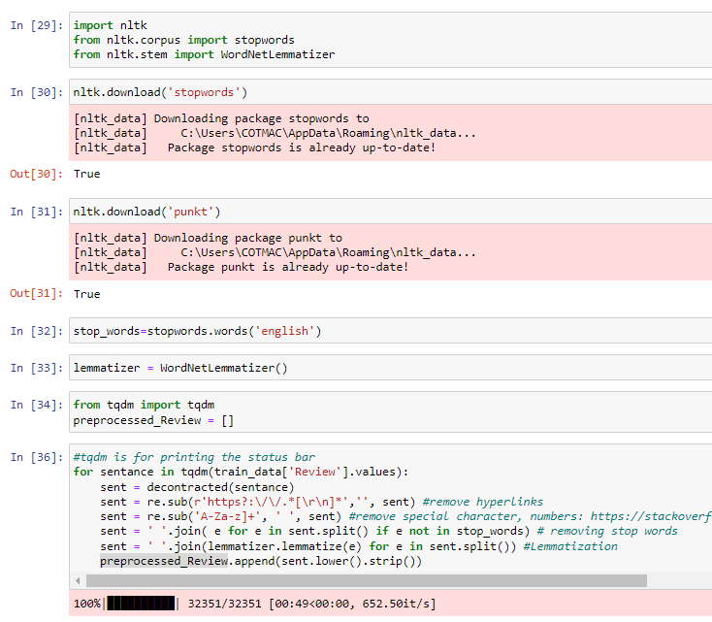
Removing Stopwords

Slide 13
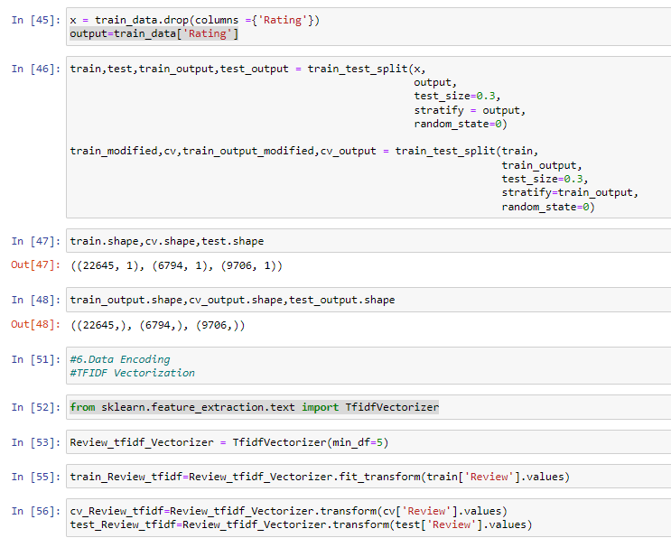
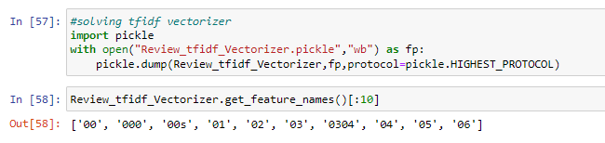
Testing of Identified Approaches (Algorithms)
We chose to consider only a small subset of the dataset, as the amazon dataset reviews. We performed an 80:30 train/test split uniformly sampled reviews based on rating, ensuring a stratified split to preserve a balanced dataset.

Slide 14
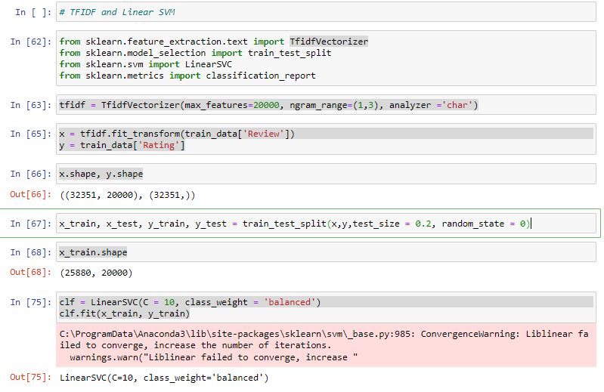
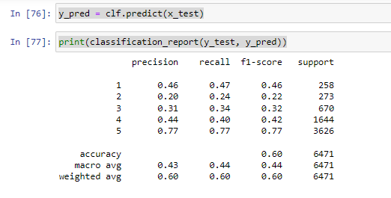
Using SVM

Slide 15
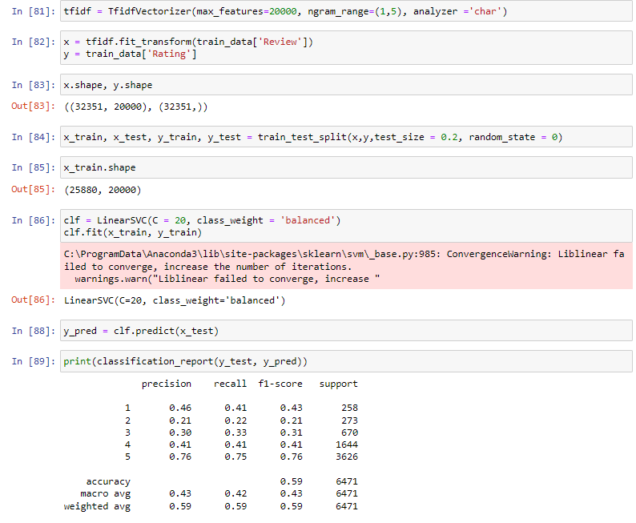
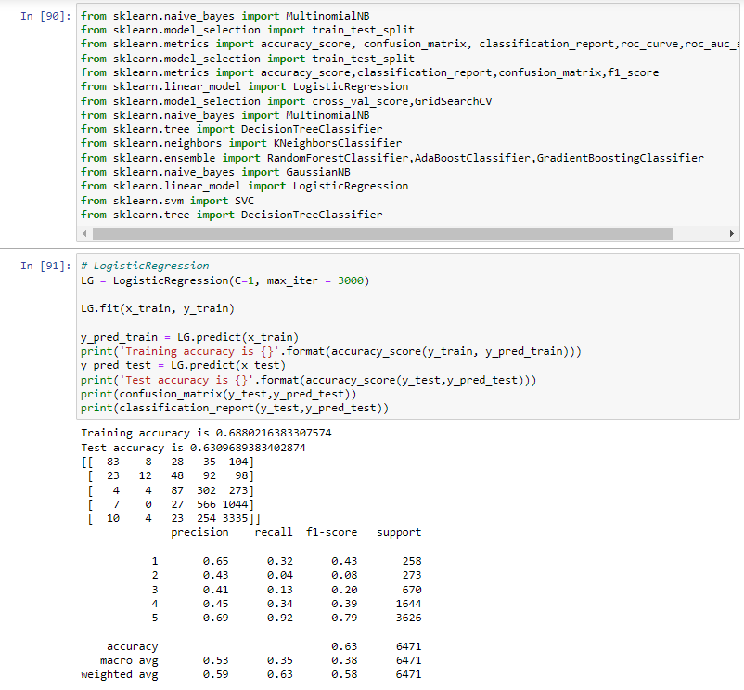
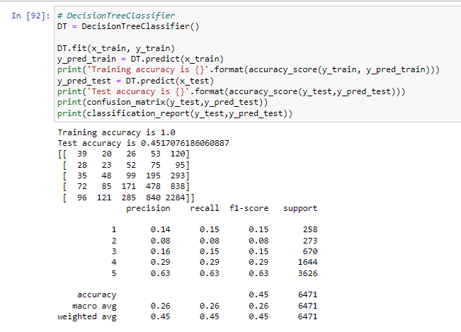
Using Models

Slide 16
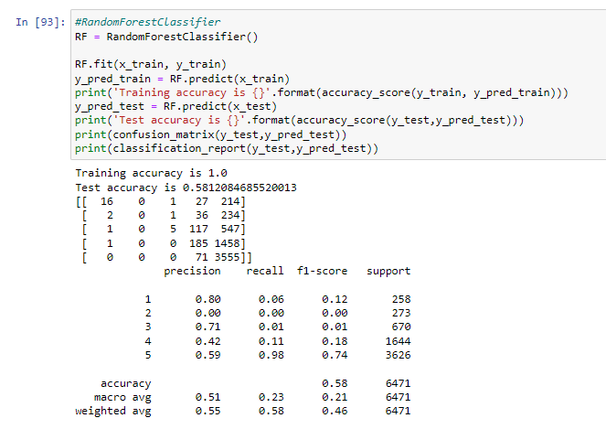
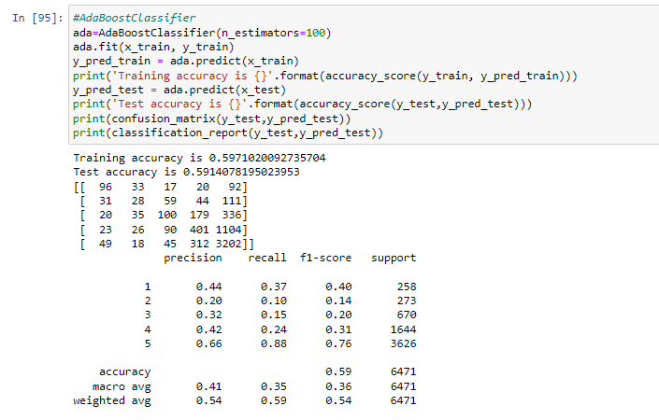
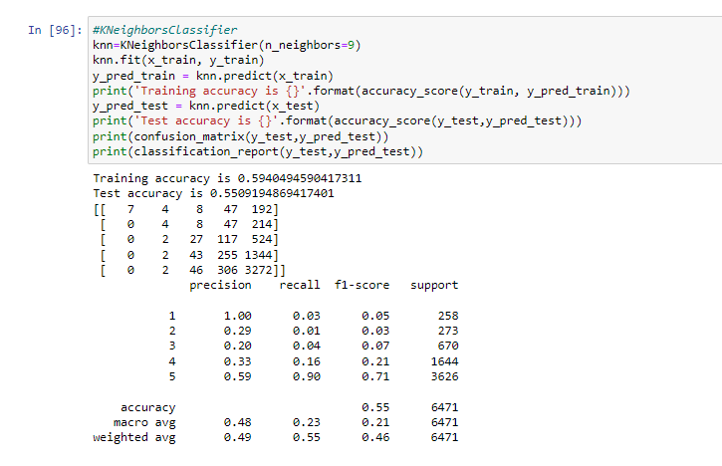
Using Models

Slide 17
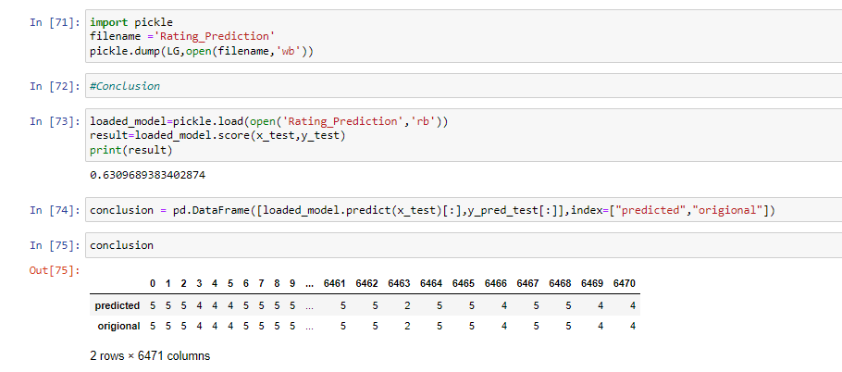
CONCLUSION
Key Findings and Conclusions of the Study
As compare multiple model Logistic Regression is better accuracy 0.63.
Learning Outcomes of the Study in respect of Data Science
As we checked in dataset present null values & the removed null values from dataset.
Pre-processing is done.
After all this split the data into train & test split

Slide 18
Limitations of this work and Scope for Future Work
The used pre-processing methods do help in the prediction accuracy. However, experimenting with different combination of pre-processing methods to achieve better prediction accuracy.
Make available features in combining the features and predict it may be improved performance

